Slide 1
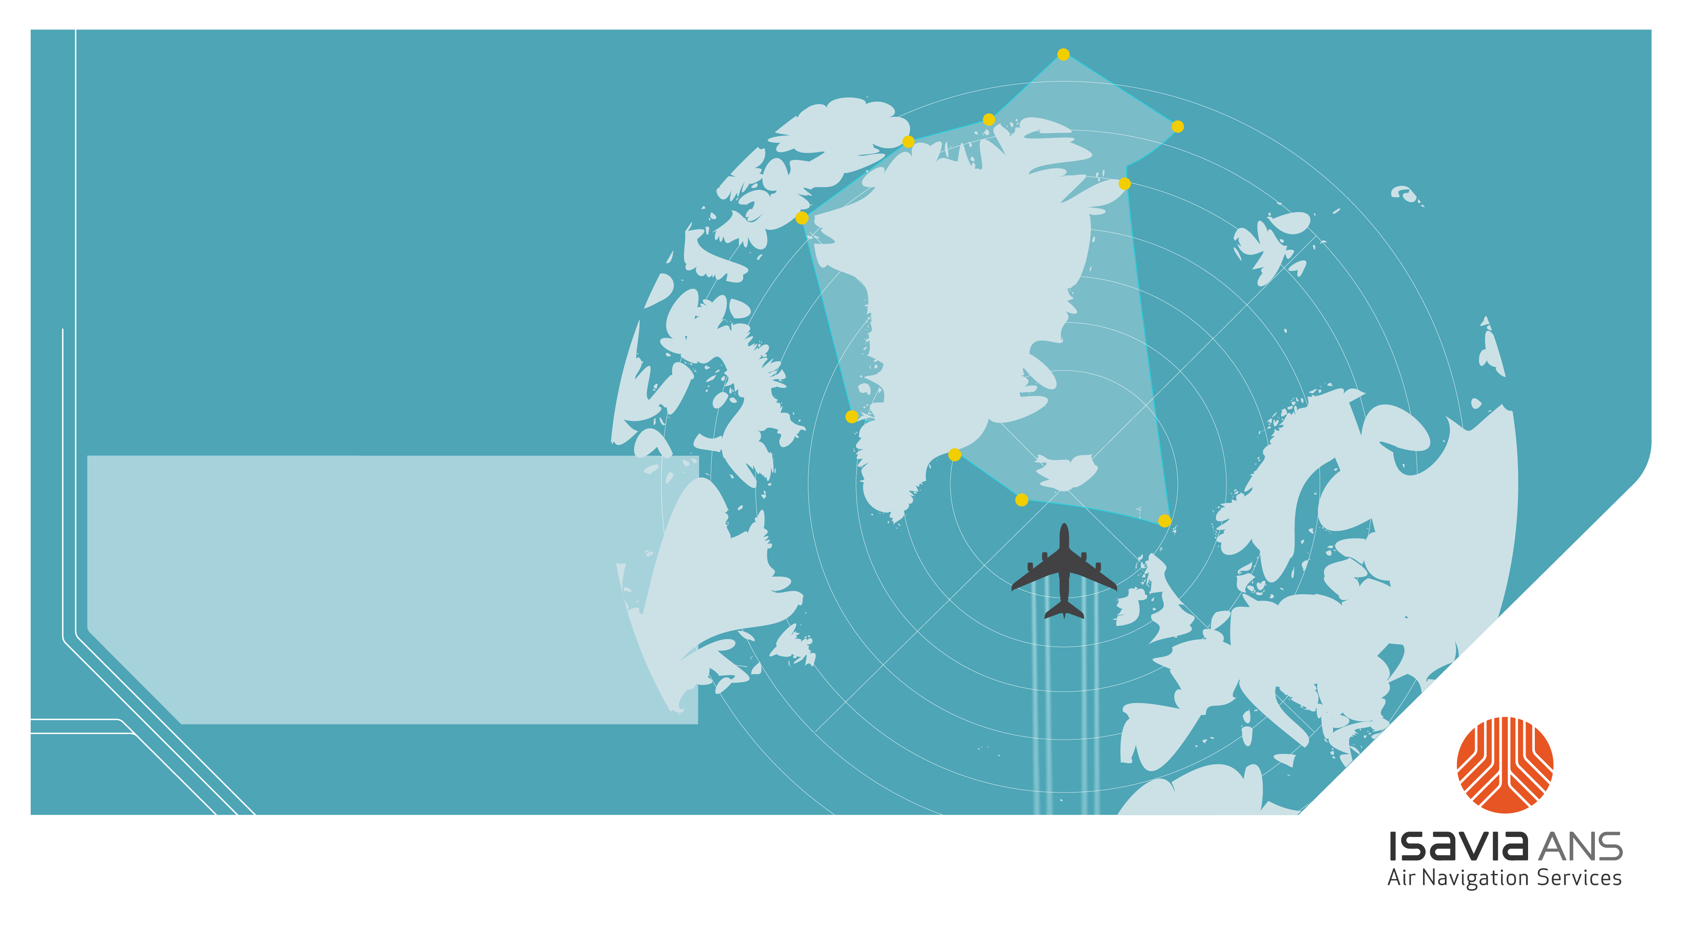
Isavia – atc fact file
Traffic – 2024

Slide 2
International traffic

Slide 3
Reykjavík control area – international traffic

Slide 4
Reykjavik control area – international traffic

Slide 5
Reykjavík control area – international traffic

Slide 6
Reykjavík control area – international traffic

Slide 7
Reykjavik control area – international traffic

Slide 8
Reykjavík control area – international traffic

Slide 9
Reykjavík control area – international traffic

Slide 10
Reykjavík control area – Int. traffic - City pairs 2024

Slide 11
Reykjavík control area – Int. traffic A/C Types 2024

Slide 12
Reykjavík control area – international traffic

Slide 13
Reykjavík control area – international traffic 2024

Slide 14
Reykjavík control area – international traffic 2024

Slide 15
Reykjavík control area – international traffic 2024

Slide 16
Reykjavík control area – international traffic 2024

Slide 17
Reykjavík control area – international traffic 2024

Slide 18
Reykjavik control area – int. traffic to and from BIKF

Slide 19
Reykjavik control area – international traffic

Slide 20
Domestic traffic

Slide 21
Reykjavík control area – domestic traffic

Slide 22
Reykjavík control area – domestic traffic

Slide 23
Reykjavík control area – domestic traffic

Slide 24
Reykjavík control area – domestic traffic

Slide 25
Reykjavik control area – dom.traffic city pairs 2024

